Slide 1

Fundamentos de Visualización de Datos
Mayo 2025

Slide 2
Contents
01
04
07
Why BI Tools​
Dashboard creation
Best Practices
02
05
08
BI Tools Interface
Advanced features
What’s new in BI Tools 2020.3
03
06
09
Charting options
Publishing
Demo

Slide 3

Why BI Tools ?
Use Case
Comparison with other Visualization Tools
BI Tools Products
BI Tools Licensing
Introduction to BI Tools​

Slide 4


Why BI Tools
BI Tools is a powerful and fastest growing data visualization tool used in the Business Intelligence Industry.
Data analysis is very fast with BI Tools and the visualizations created are in the form of dashboards and worksheets.
Why BI Tools?
The best feature of BI Tools are Data Blending, Real Time Analysis, Collaboration of data
Visualization in BI Tools can be understood by professional at any level in an organization.

Slide 5
Use Cases
Bring multiple data sources into one single point of truth
Perform basic ETL operations quickly
When to Use BI Tools
Provide beautiful dashboards and reports
Conduct investigative or exploratory analysis at the speed of thought
Control data, access, user permissions and dashboards in a secure and scalable format both on-premise or in the cloud.
Geodata representation

Slide 6
Comparison with other Visualization Tools
 | Tableau | Power BI | QlikView | SAC
About tool | Market Leader in the Visualizations | Self-service and data preparation tool from Microsoft | Self-service Business Intelligence, Guided data Analytics, and Data Visualization tool. | Cloud based Analytics solution from SAP
Features | The best features of BI Tools are Data Blending, Real Time Analysis, Collaboration of data, Translates queries to visualizations | NLP feature and shared workspaces | Interact with dynamic apps, dashboards and analytics, Natural search, App scripts and Workbench | Good for Predictive Analytics, Planning and extended to digital boardroom
USP | Best user interface, Visualizations, Connectivity | Custom column suggestions and run time calculated tables | Automatic Data association, In-memory data processing, Unique data discovery & Global search | What-if tree, value driven tree
Connectivity | Large number of diverse native connectors, supports 100+ data sources | Best connectivity with Microsoft tools | Connects to nearly any data source via OBDC, Restful API or Web Connector. | Best connectivity with SAP Cloud platform
HANA Access | HANA Import and Live access via ODBC (also provides direct access to tables) | HANA Import and Live access via ODBC | HANA Import and Live access via ODBC | Live connection via HTTP server, Web dispatcher, direct connection SSO
Desktop tool | Yes (Supported on Windows & MAC OS) | Yes (Support on Windows) | Yes (Supported on Windows & MAC OS) | No Desktop client
Security | BI Tools managed user authentication. SAML (SAP HANA) and Kerberos (SAP BW) SSO supported | User accounts linked to office365 (multiple auth. Mode) | Authentication – Integrated windows, HTTP header, Qlik customer directory | Role based security in SAC and supports SAML SSO
Licensing cost | Flexible pricing BI Tools desktop professional-$70 user/month BI Tools server-$35/user/month BI Tools online-$42/user/month | Basic is free with office365 Pro-$9.99/user/month Premium-$4995/node/month | Personal Edition– Free Named User– $1,395/user Document– $360/user/document Concurrent License – $15,495/concurrent user Server Enterprise Edition– $36,150/Server | SAC for BI– $24.00/user/month SAC for Planning – starts at $157.00/user/month

Slide 7
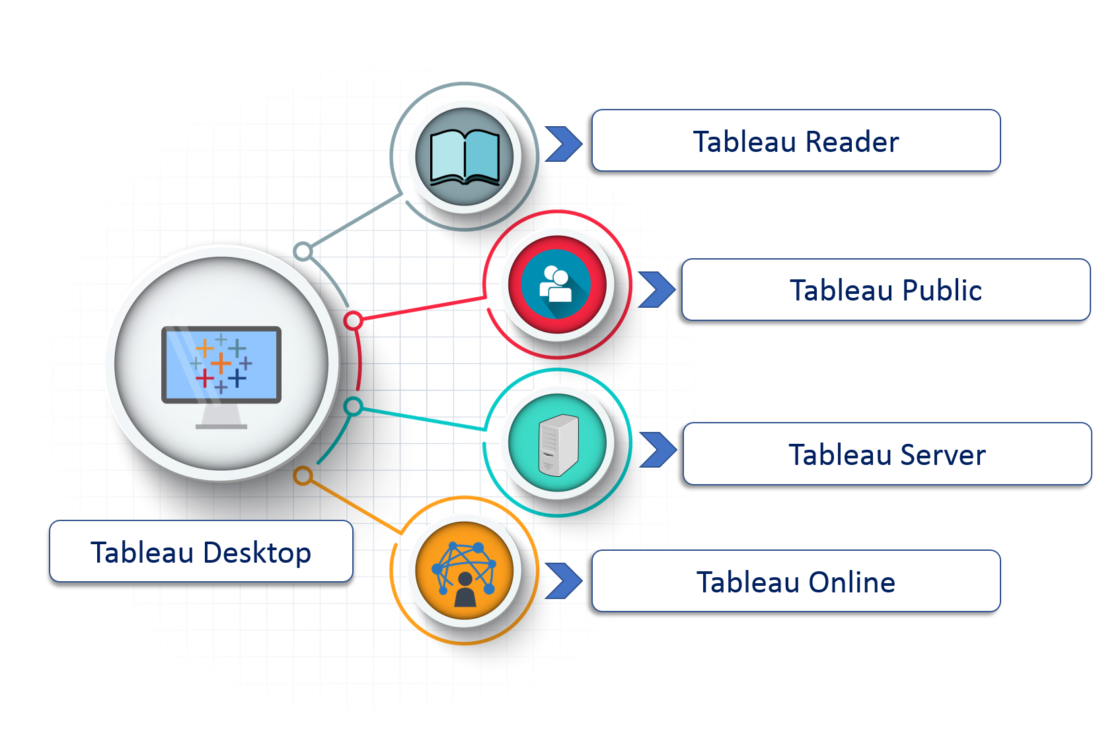
BI Tools Products Flavors
BI Tools Desktop: Allows one to create and publish charts and dashboards.
BI Tools Reader: Allows one to view visualizations and workbooks generated using BI Tools Public or BI Tools Desktop
BI Tools Public: It is a free service that lets anyone create and publish interactive data visualizations to the web but cannot save locally.
BI Tools Server: This is mainly used to share visualizations and workbooks which get generated in the BI Tools Desktop application throughout the organization
BI Tools Online: BI Tools Online is a sharing tool. It has a similar usage as BI Tools Server, but the data is saved on servers which are provided in the cloud maintained by the BI Tools
BI Tools Prep: BI Tools Prep builder is a new product of BI Tools which helps developers to cleanse, blend and transform the raw data from different sources and save the file as output.

Slide 8
BI Tools Connections
BigData Connections
Data Pre-Processing
BI Tools Interface​

Slide 9
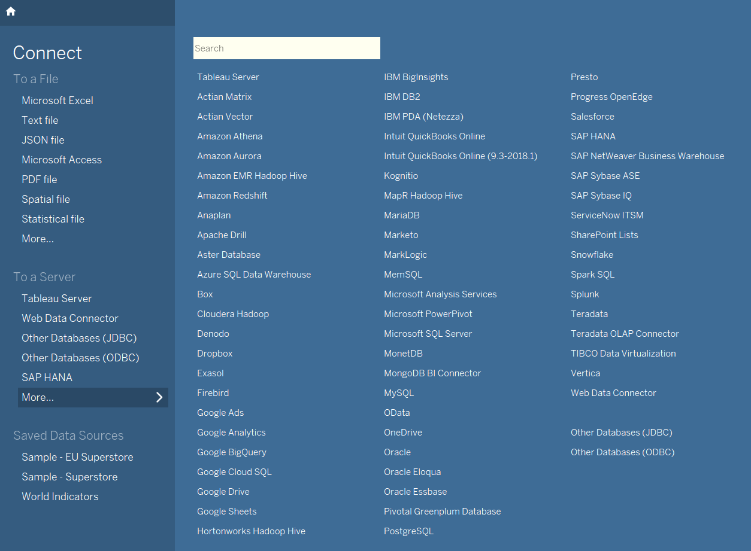
BI Tools Connections
Connection Sources
Table is a versatile tool, able to connect to most of the servers or files.
Few significant connections SAP NetWeaver BW, SAP HANA, OData, Oracle. Google BQ, MySQL etc..
It supports generic DB connections using ODBC or JDBC services.

Slide 10
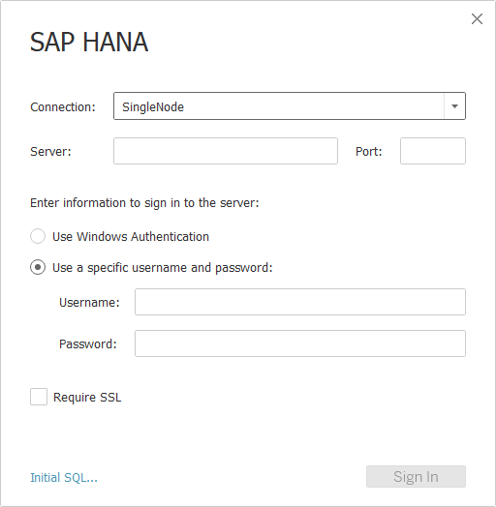
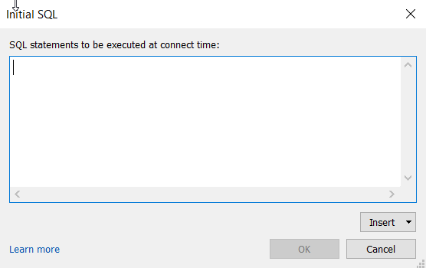
Connections (SAP HANA based example)
Connection to Database
Host name, Port along with user authentication are the basic requirement to connect to HANA DB
Custom SQLs can be created to fetch data in terms of Live connection. Initial SQL help retrieve filtered data depending the SQL at connection level.
Note: Required SAP HANA DB CLIENT drivers to be installed for BI Tools Desktop to be connected to HANA DB.

Slide 11
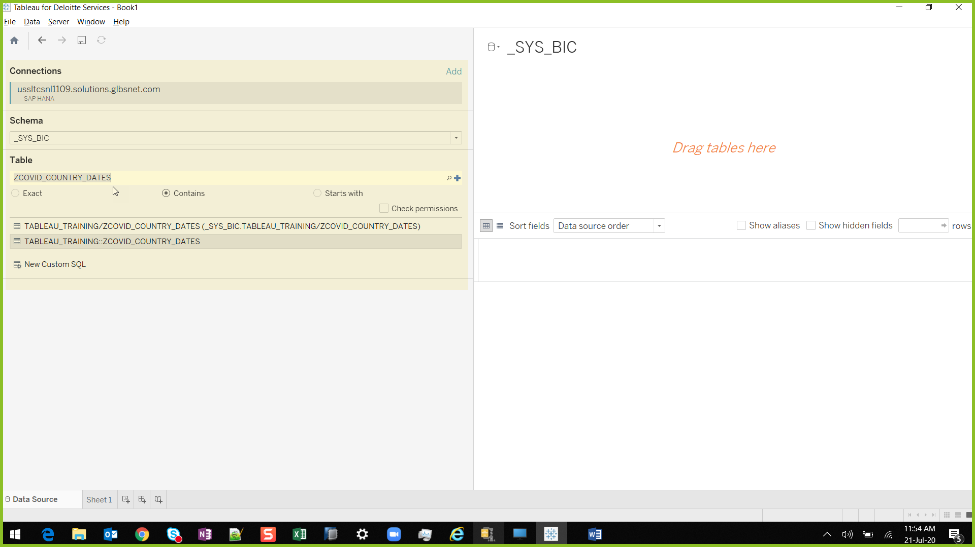
Connections (SAP HANA based example)
Connection to Database Objects
Once the Database connection is made, ability to search for catalog objects is presented.
If a view is activated in HANA, the view is stored in _SYS_BIC schema.
Searching the view name will present the object which can be dragged and dropped into the right pane to make it a data source

Slide 12
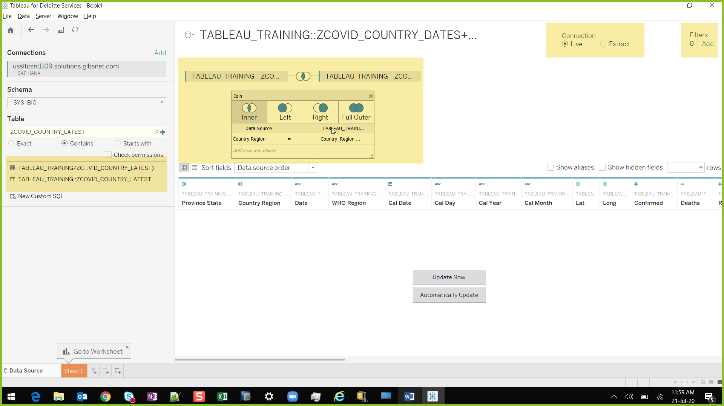
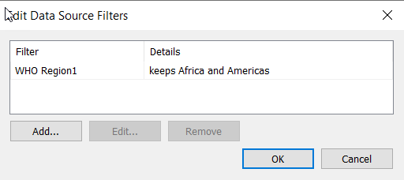
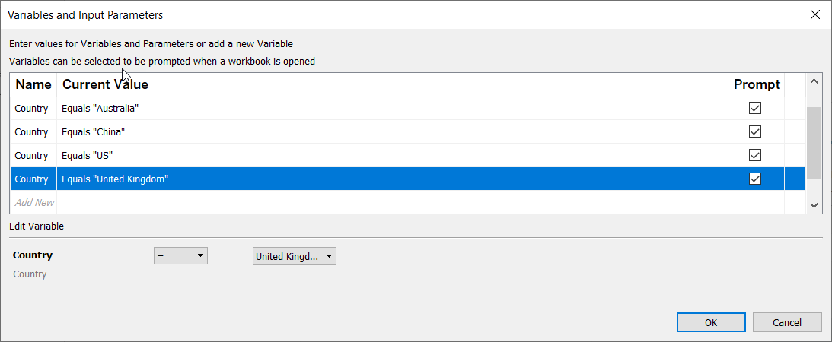
Connections (SAP HANA based example)
Object relationships, connection types, Parameters and Filters
If multiple Data sources are added, they can be joined through common entities (Primary/Foreign keys)
Ability to choose between Extract and Live Data source is presented.
Filters can be added at each Data source level which act upon only on the respective query.
If an Input parameter exists in underlying models, ability to select default values are presented once the connection is added.

Slide 13
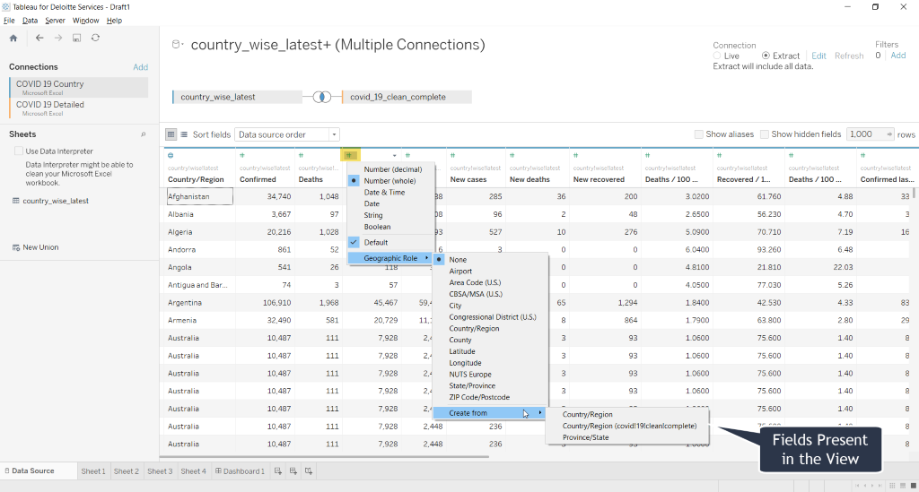
Data Pre-Processing
Metadata Manipulations
Once Data is imported, data types can be manipulated by clicking on the left top icon of field name.
Additionally, Geographic Roles such as Country, State, City etc can be assigned to certain dimension fields. BI Tools automatically picks up the location from their servers.

Slide 14
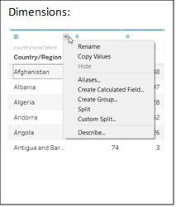
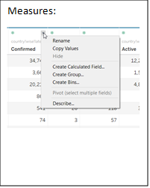
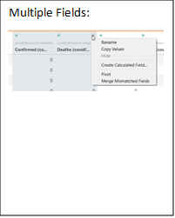
Data Pre-Processing
For Dimensions,
“Calculated fields” can be created.
Data can be “Split” into multiple column with a custom delimiter.
Fields can be “Grouped” based on the data
For Measures,
“Calculated fields” measures can be created.
Groups and Bins can be created based on the value held by the Measure
When Multiple Fields are selected
Fields can be Pivoted across the entire table.
Values from different fields can be “Merged” based on mismatch condition
Additionally,
Fields can be renamed or given alias
Fields can be hidden
Properties/Metadata of each field can be seen by selecting “Describe” option

Slide 15
Chart Types
Usage
Charts

Slide 16
Chart Types
Tree Map
Donut Chart
Trend Lines
Table
Line Graph
Pareto Chart
World Map
Waterfall Chart
Heat Map
Motion Chart

Slide 17
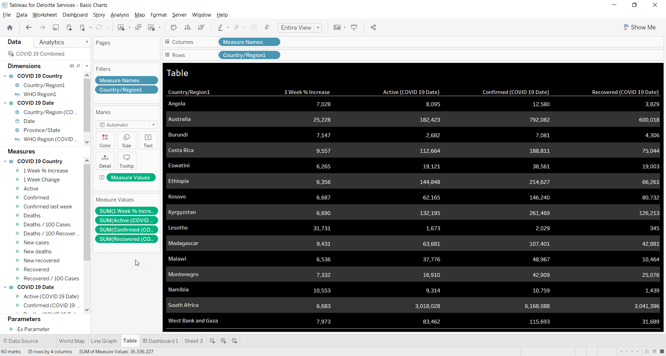
Table
When to Use:
The most basic of graphics we are used is Tables.
Tables are to be used to view information at lowest level of granularity.
Minimum Requirement:
1 or more Dimension ,
1 or more Measures
Purpose:
Tables are used when there is finite amount of data.
Usually used in tandem with Rank Parameters.

Slide 18
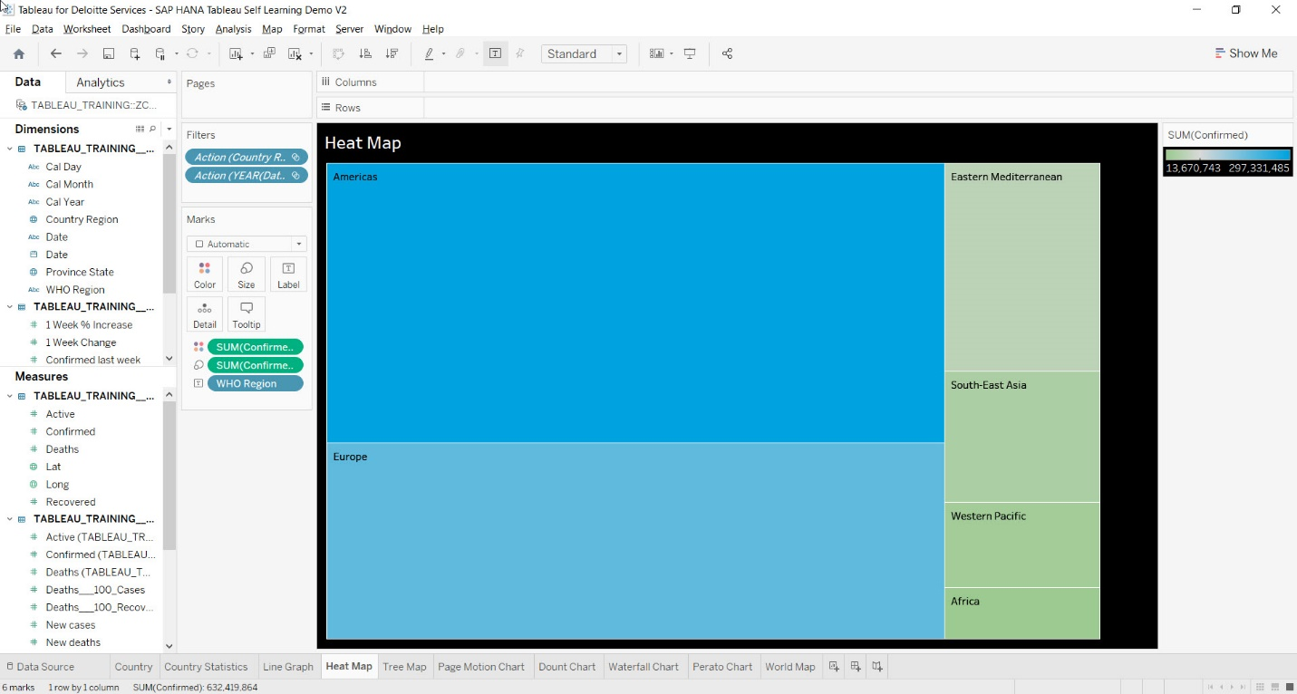
Heat Map
When to Use:
Uses size and color as visual cues to describe the data. Allows us to easily tell a story about the data
Minimum Requirement:
1 Dimension ,
1 or 2 Measures
Purpose:
Heat Map is used to display the data along with colors.
Heat Map in BI Tools will help to compare the data by their color.

Slide 19
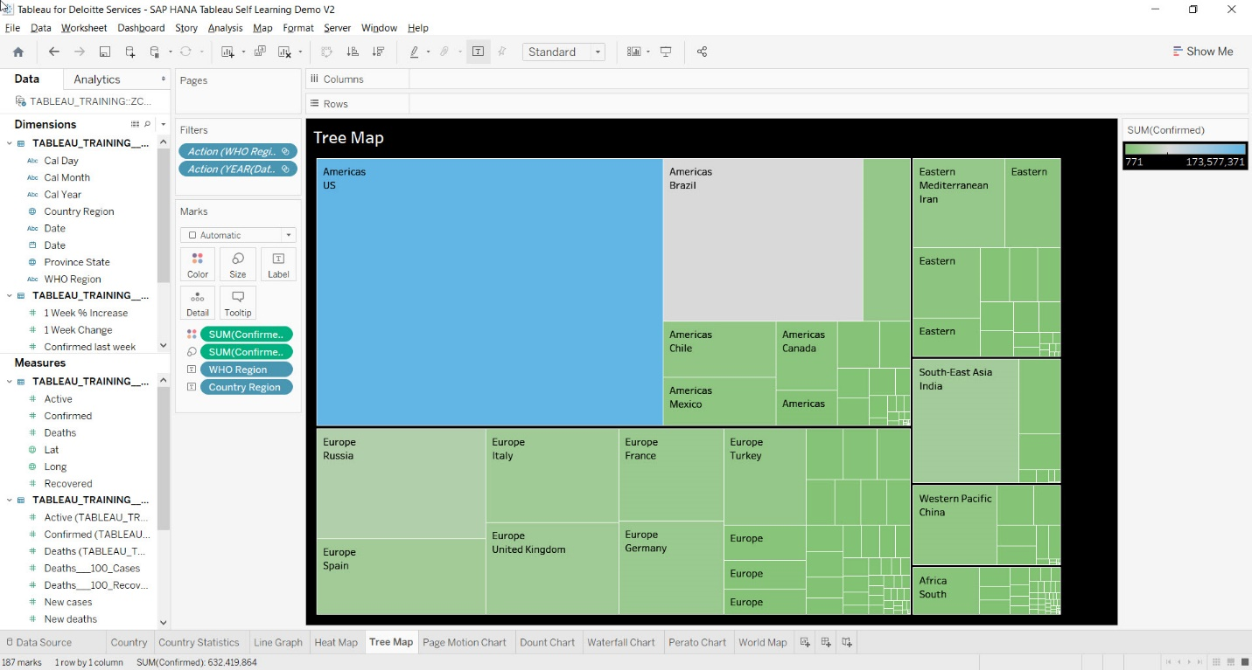
Tree Map
When to Use:
You can use a Tree map to show hierarchical (tree-structured) data relationships. Tree map is ideal and part-to-whole for showing large amounts of items in a single visualization simultaneously.
This view is very similar to a heat map, but the boxes are grouped by items that are close in hierarchy.
Minimum Requirement:
1 or more Dimensions,
1 or 2 Measures
Purpose:
Tree maps represent part-to-whole and hierarchical relationships using a series of rectangles.
The dimensions define the structure of the tree map and measures define the size or color of the individual rectangle.

Slide 20
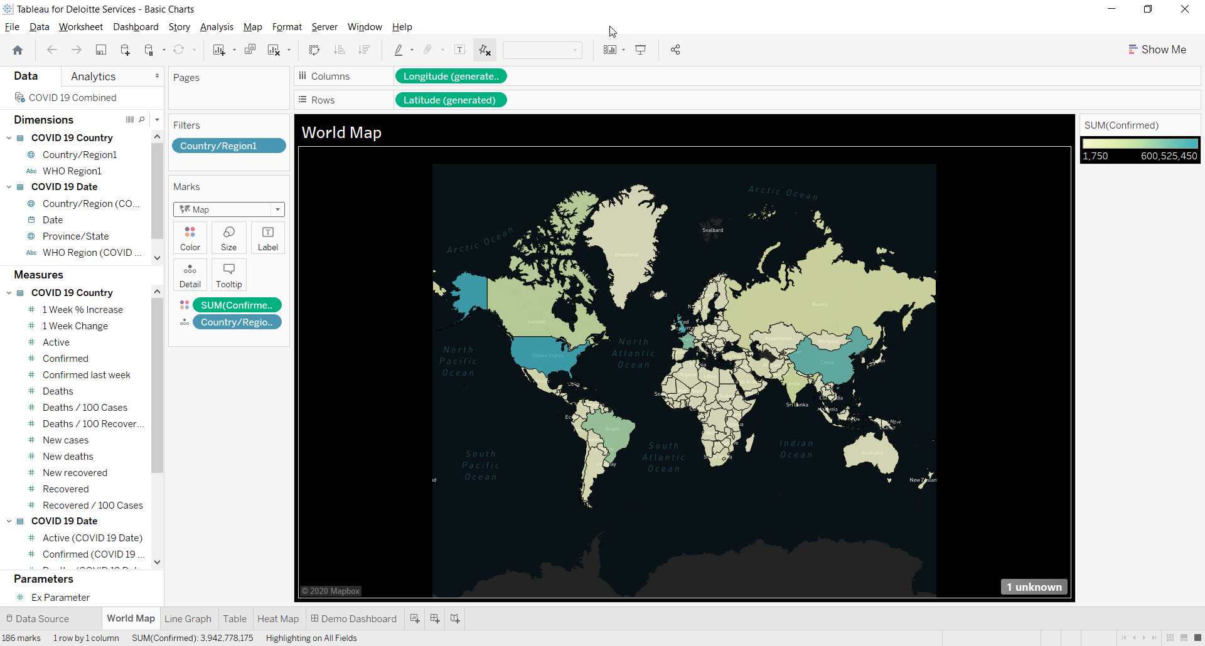
World Map
When to Use:
To gain insights of comparative performance of different locations, either world wide or for a particular country, World maps represents the data at glance.
Minimum Requirement:
1 Geographical Location,
0 or 1 Measure
Purpose:
World map relationships between different geographic locations.
The geographical locations define the structure of the World map and measures define the color of the individual locations.

Slide 21
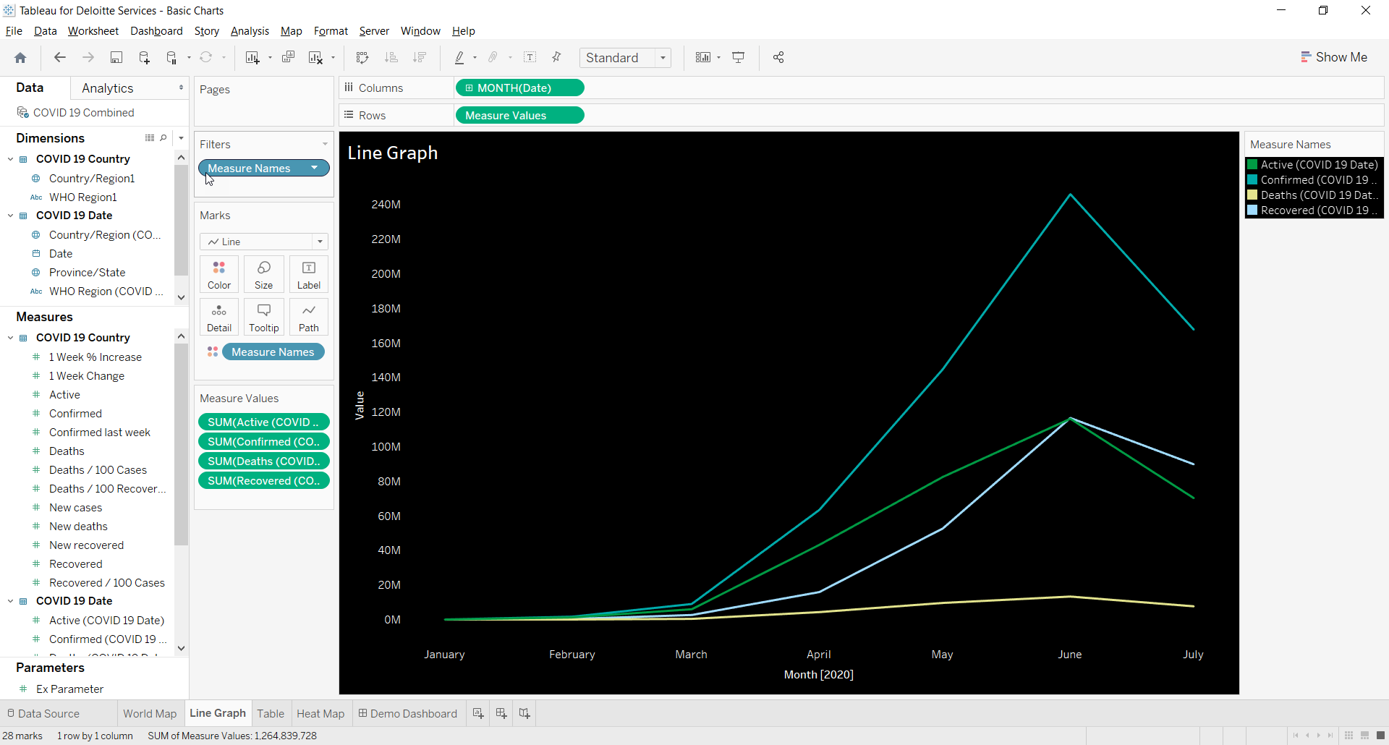
Line Graph
When to Use:
Line graph is used to view data changes over time. The graph can have multiple measures represented by different colors. This helps co-relate multiple measures over the period of time
Minimum Requirement:
1 Time Dimension and
1 or more Measures
Purpose:
Line charts show data using the X and Y-axes, displaying changes over time by showing the movement of data points.

Slide 22
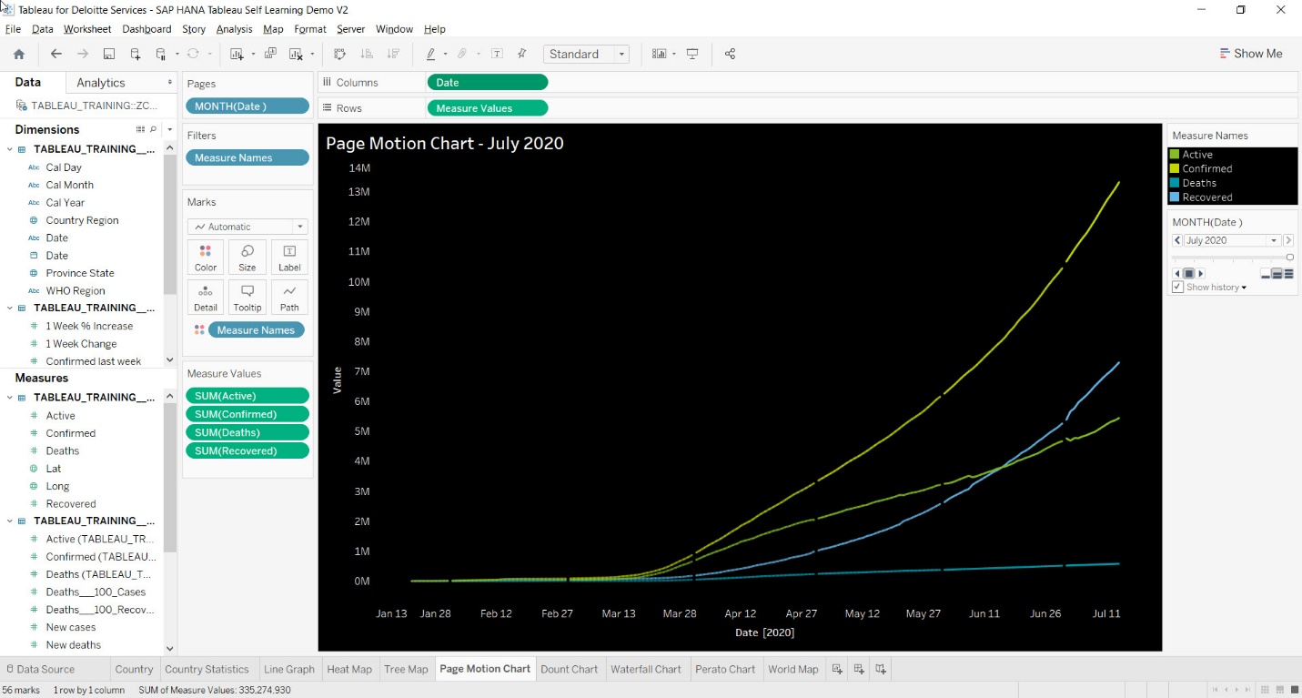
Motion Chart
When to Use:
Motion charts are an enhancement to line Charts.
These show the movement of data points over period of time with animations.
Minimum Requirement:
1 Time Dimension and
1 or more Measures
Purpose:
Motion charts show data using the X and
Y-axes, displaying changes over time
by showing the movement of data points within the defined space.
The main advantage of motion chart is to view the entire trail of how the data has changed over time and not just a snapshot of the data.

Slide 23
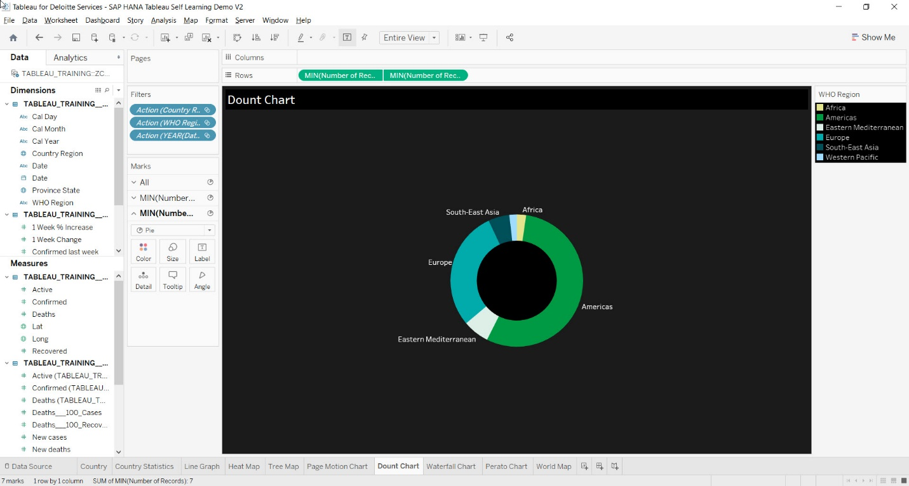
Donut Chart
When to Use:
Donut or Pie Charts are best suited to show proportional or percentage relationships. When used appropriately, these can quickly show relative value to the other data points in the measure.
These are not always accurate in depicting the data since the values are proportional relationships. It is recommended to be used when lesser number of Dimensions are present
Minimum Requirement:
1 or more Dimension,
1 or 2 Measures
Purpose:
It is a pie chart with a hole in the middle, but it helps put more emphasis on the various segments.
A donut chart, like a pie chart, shows part-to-whole relationships

Slide 24
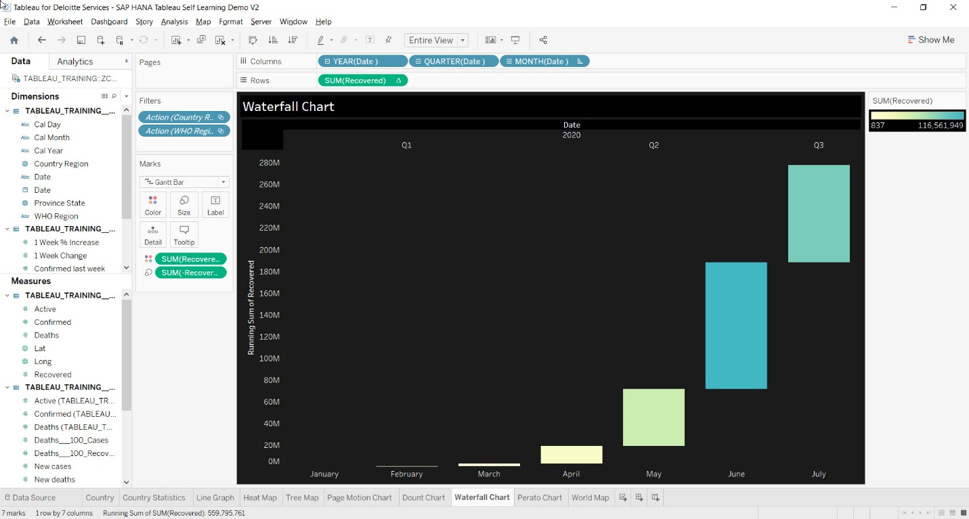
Waterfall Chart
When to Use:
Waterfall charts are to be used for incremental data values. The charts represents
values increase over a period of time
Minimum Requirement:
1 Time Dimension and
1 or more Measures
Purpose:
Waterfall charts effectively display the cumulative effect of sequential positive and negative values.
It shows where a value starts, ends and how it gets there incrementally.

Slide 25
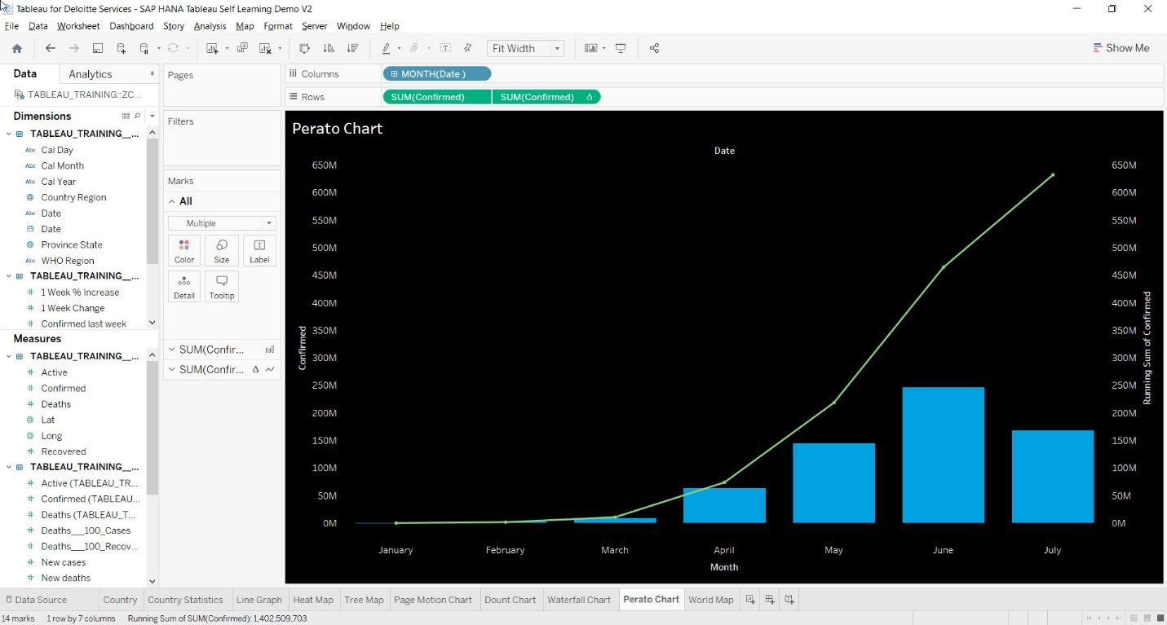
Pareto Chart
When to Use:
Pareto charts are often used for Risk Management to determine the most common problems that are having the most negative impact on a project.
Minimum Requirement:
Depends on the types of Charts used
Purpose:
A Pareto chart is a type of chart that contains both bars and a line graph, where individual values are represented in descending order by bars, and the ascending cumulative total is represented by the line.
Each graph is represented by two different axis

Slide 26
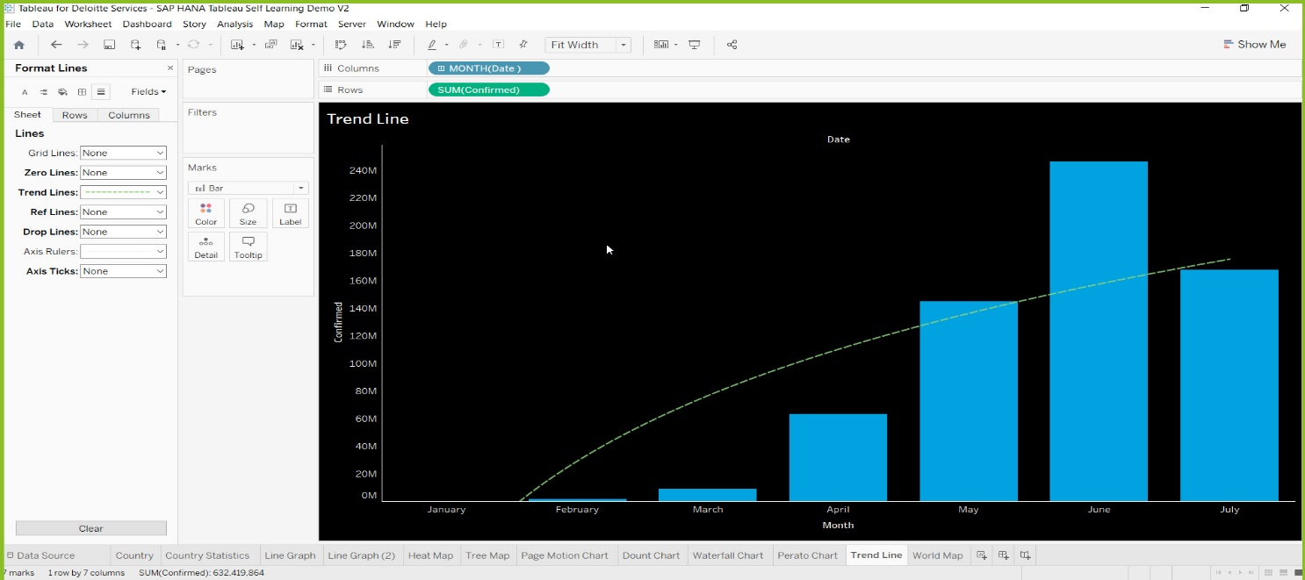
Trend Lines
When to Use:
Trend lines are used to predict the continuation of a certain trend of a variable. It also helps to identify the correlation between two variables by observing the trend in both of them simultaneously
Minimum Requirement:
Depends on the types of Charts used
Types of Trend Line:-
Linear
Logarithmic
Exponential
Polynomial
Power

Slide 27
Dashboard
Creation

Slide 28
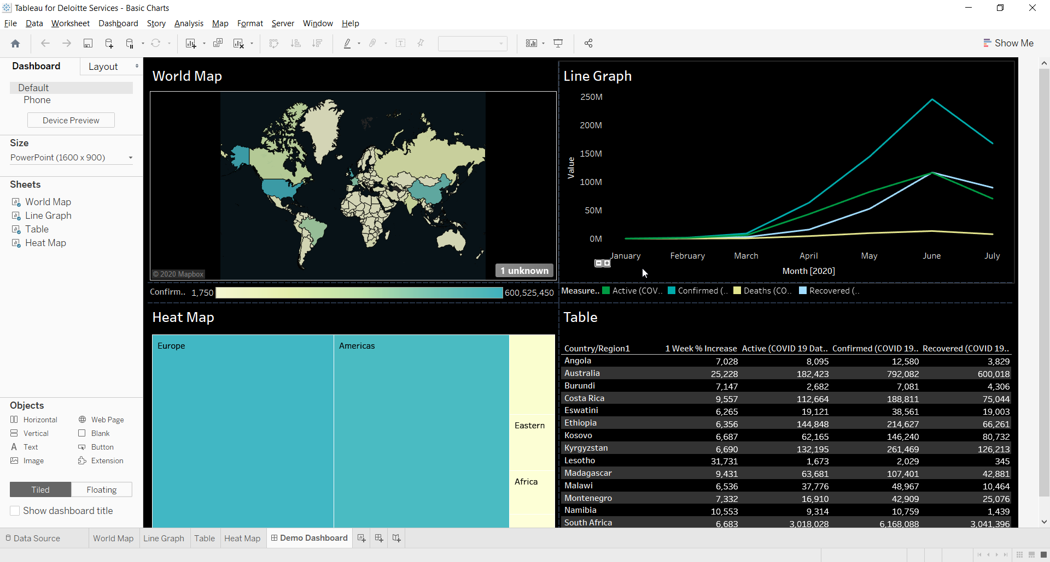
Dashboard
A Dashboard is a collection of Worksheets.
Dashboard brings relational perspective for all the Worksheets present in it.
Dashboards are highly interactive in nature.
Entire data set across worksheets can be filtered by selecting an element in any worksheet.
User Selection/Parameters can be used to either filter on specific worksheets or the entire dashboard or the entire data set
Webpages can directly be added into a Dashboard

Slide 29
Dashboard (Contd.)
A Dashboard is a collection of Worksheets.
A custom button can be created for purposes such as switching between dashboards or filtering etc…
Dashboard can be formatted as a normal worksheet can be.
Additionally Dashboard’s has the ability to customize the layout elements such as setting
Height and width as fixed or automatic or according to the device being used.
Padding between elements.
Have floating elements on top of other elements

Slide 30
Drill Down - Level of Detail
Forecasting
Modelos
Advance Feature​s

Slide 31
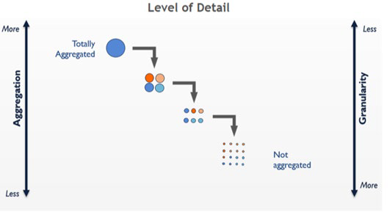
Drill Down - Level of detail expressions
Drill Down expressions give you more control on the level of granularity you want to compute. LOD Expressions provide a easy way to compute aggregations that are not at the level of detail of the visualization.
They can be performed at a more granular level (INCLUDE), a less granular level (EXCLUDE), or an entirely independent level (FIXED)
FIXED:- FIXED level of detail expressions compute a value using the specified dimensions, without reference to the dimensions in the view.
{ FIXED [Region] : SUM( [Sales] ) }
INCLUDE:- INCLUDE level of detail expressions compute values using the specified dimensions in addition to whatever dimensions are in the view.
{ INCLUDE [Region] : SUM( [Sales] ) }

Slide 32
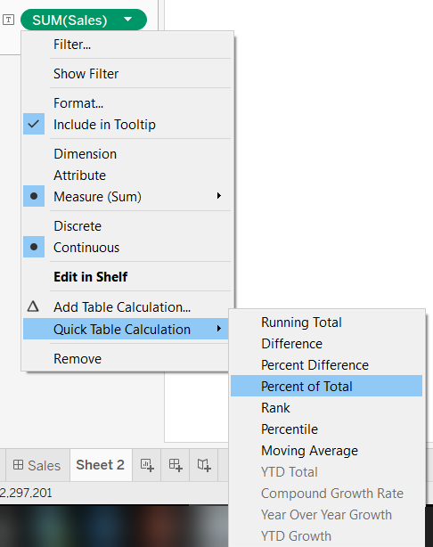
Table Calculations
Table calculations are done based on output in BI Tools.
Some of the cases where we use table calculations are:-
•Ranking
•Recursion (e.g. cumulative totals)
•Moving calculations (e.g. rolling averages)
•Inter-row calculations (e.g. period vs. period calculations)
•WINDOW_AVG (WINDOW_AVG(expression, [start, end])
•WINDOW_SUM (WINDOW_SUM(expression, [start, end])

Slide 33

Dimension
An entity on which analysis is to be performed (e.g. Customers)
Consists of:
Attributes that describe the entity
Hierarchies that organize dimension members in meaningful ways
Customer ID | First Name | Last Name | State | City | Marital Status | Gender | … | Age
123 | John | Doe | WA | Seattle | Married | Male | … | 42
456 | Lance | Smith | WA | Redmond | Unmarried | Male | … | 34
789 | Jill | Thompson | OR | Portland | Married | Female | … | 21

Slide 34
Attribute
Containers of dimension members.
Completely define the dimensional space.
Enable slicing and grouping the dimensional space in interesting ways.
Customers in state WA and age > 50
Customers who are married and male
Typically have one-many relationships
City → State, State → Country, etc.
All attributes implicitly related to the key

Slide 35
Hierarchy
Ordered collection of attributes into levels
Navigation path through dimensional space
User defined hierarchies – typically multiple levels
Attribute hierarchies – implicitly created for each attribute – single level
Customers by Geography
Customers by Demographics
Country
Marital
State
Gender
City
Customer
Customer

Slide 36
Dimension Model
Country
Country
State
Marital
City
Gender
Gender
State
Customer
Customer
Customer
City
Gender
Marital
Age
Customer
State
Gender
Customer
City
Country
Marital
Attributes
Hierarchies

Slide 37
Cube
Collection of dimensions and measures
Measure → numeric data associated with a set of dimensions (e.g. Qty Sold, Sales Amount, Cost)
Multi-dimensional space
Defined by dimensions and measures
E.g. (Customers, Products, Time, Measures)
Intersection of dimension members and measures is a cell (USA, Bikes, 2004, Sales Amount) = $1,523,374.83

Slide 38
A Cube
Units of beer consumed in
Boston in January
Bos
Conuntries
NYC
Chi
Mar
Sea
Feb
Jan
Tiempo
Peas
Corn
Bread
Milk
Beer
Regiones

Slide 39
Measure Group
Group of measures with same dimensionality
Analogous to fact table
Cube can contain more than one measure group
E.g. Sales, Inventory, Finance
Multi-dimensional space
Subset of dimensions and measures in the cube
AS2000 comparison
Virtual Cube → Cube
Cube → Measure Group

Slide 40

Measure Group
Measure Group
 | Sum of Sales | Qty, Inventory | Sum, Avg, Finance
Customers | X
Products | X | X
Time | X | X | X
Promotions | X
Warehouse |  | X
Department |  |  | X
Account |  |  | X
Scenario |  |  | X

Slide 41
Top 3 Tenets of Good Cube Design
Attribute relationships
Attribute relationships
Attribute relationships

Slide 42
Attribute Relationships
One-to-many relationships between attributes
Server simply “works better” if you define them where applicable
Examples:
City → State, State → Country
Day → Month, Month → Quarter, Quarter → Year
Product Subcategory → Product Category
Rigid v/s flexible relationships (default is flexible)
Customer → City, Customer → PhoneNo are flexible
Customer → BirthDate, City → State are rigid
All attributes implicitly related to key attribute

Slide 43
Attribute Relationships (continued)
City
Gender
Marital
Age
State
Customer
Country

Slide 44
Attribute Relationships (continued)
Country
State
City
Gender
Marital
Age
Customer

Slide 45
Attribute Relationships Where are they used?
MDX Semantics
Tells the formula engine how to roll up measure values
If the grain of the measure group is different from the key attribute (e.g. Sales by Month)
Attribute relationships from grain to other attributes required (e.g. Month → Quarter, Quarter → Year)
Otherwise no data (NULL) returned for Quarter and Year
MDX Semantics explained in detail at:
http://www.sqlserveranalysisservices.com/OLAPPapers/AttributeRelationships.htm

Slide 46
Attribute Relationships Where are they used?
Storage
Reduces redundant relationships between dimension members – normalizes dimension storage
Enables clustering of records within partition segments (e.g. store facts for a month together)
Processing
Reduces memory consumption in dimension processing – less hash tables to fit in memory
Allows large dimensions to push 32-bit barrier
Speeds up dimension and partition processing overall

Slide 47
Attribute Relationships Where are they used? (cont.)
Query performance
Dimension storage access is faster
Produces more optimal execution plans
Aggregation design
Enables aggregation design algorithm to produce effective set of aggregations
Dimension security
DeniedSet = {State.WA} should deny cities and customers in WA – requires attribute relationships
Member properties
Attribute relationships identify member properties on levels

Slide 48
Attribute Relationships How to set them up?
Creating an attribute relationship is easy, but …
Pay careful attention to the key columns!
Make sure every attribute has unique key columns (add composite keys as needed)
There must be a 1:M relation between the key columns of the two attributes
Invalid key columns cause a member to have multiple parents
Dimension processing picks one parent arbitrarily and succeeds
Hierarchy looks wrong!

Slide 49
Attribute Relationships How to set them up?
Don’t forget to remove redundant relationships!
All attributes start with relationship to key
Customer → City → State → Country
Customer → State (redundant)
Customer → Country (redundant)

Slide 50
Attribute Relationships Example
Time dimension
Day, Week, Month, Quarter, Year
Year: 2003 to 2010
Quarter: 1 to 4
Month: 1 to 12
Week: 1 to 52
Day: 20030101 to 20101231
Year
Quarter
Week
Month
Day

Slide 51
Attribute Relationships Example
Time dimension
Day, Week, Month, Quarter, Year
Year: 2003 to 2010
Quarter: 1 to 4 - Key columns (Year, Quarter)
Month: 1 to 12
Week: 1 to 52
Day: 20030101 to 20101231
Year
Quarter
Week
Month
Day

Slide 52
Attribute Relationships Example
Time dimension
Day, Week, Month, Quarter, Year
Year: 2003 to 2010
Quarter: 1 to 4 - Key columns (Year, Quarter)
Month: 1 to 12 - Key columns (Year, Month)
Week: 1 to 52
Day: 20030101 to 20101231
Year
Quarter
Week
Month
Day

Slide 53
Attribute Relationships Example
Time dimension
Day, Week, Month, Quarter, Year
Year: 2003 to 2010
Quarter: 1 to 4 - Key columns (Year, Quarter)
Month: 1 to 12 - Key columns (Year, Month)
Week: 1 to 52 - Key columns (Year, Week)
Day: 20030101 to 20101231
Year
Quarter
Week
Month
Day

Slide 54
User Defined Hierarchies
Pre-defined navigation paths thru dimensional space defined by attributes
Attribute hierarchies enable ad hoc navigation
Why create user defined hierarchies then?
Guide end users to interesting navigation paths
Existing client tools are not “attribute aware”
Performance
Optimize navigation path at processing time
Materialization of hierarchy tree on disk
Aggregation designer favors user defined hierarchies

Slide 55
Natural Hierarchies
1:M relation (via attribute relationships) between every pair of adjacent levels
Examples:
Country-State-City-Customer (natural)
Country-City (natural)
State-Customer (natural)
Age-Gender-Customer (unnatural)
Year-Quarter-Month (depends on key columns)
How many quarters and months?
4 & 12 across all years (unnatural)
4 & 12 for each year (natural)

Slide 56
Natural Hierarchies Best Practice for Hierarchy Design
Performance implications
Only natural hierarchies are materialized on disk during processing
Unnatural hierarchies are built on the fly during queries (and cached in memory)
Server internally decomposes unnatural hierarchies into natural components
Essentially operates like ad hoc navigation path (but somewhat better)
Create natural hierarchies where possible
Using attribute relationships
Not always appropriate (e.g. Age-Gender)

Slide 57
Best Practices for Cube Design
Attributes
Define all possible attribute relationships!
Mark attribute relationships as rigid where appropriate
Use integer (or numeric) key columns
Hierarchies
Use natural hierarchies where possible
Use many-to-many dimensions prudently
Slower than regular dimensions, but faster than calculations
Intermediate measure group must be “small” relative to primary measure group

Slide 58
Best Practices for Cube Design
Measures
Use smallest numeric data type possible
Use semi-additive aggregate functions instead of MDX calculations to achieve same behavior
Put distinct count measures into separate measure group (BIDS does this automatically)
Avoid string source column for distinct count measures

Slide 59
Partitioning
Mechanism to break up large cube into manageable chunks
Partitions can be added, processed, deleted independently
Update to last month’s data does not affect prior months’ partitions
Sliding window scenario easy to implement
E.g. 24 month window → add June 2006 partition and delete June 2004
Partitions can have different storage settings
Partitions require Enterprise Edition!

Slide 60
Benefits of Partitioning
Partitions can be processed and queried in parallel
Better utilization of server resources
Reduced data warehouse load times
Queries are isolated to relevant partitions → less data to scan
SELECT … FROM … WHERE [Time].[Year].[2006]
Queries only 2006 partitions
Bottom line → partitions enable:
Manageability
Performance
Scalability

Slide 61
Best Practices for Partitioning
No more than 20M rows per partition
Specify partition slice
Optional for MOLAP – server auto-detects the slice and validates against user specified slice (if any)
Must be specified for ROLAP
Manage storage settings by usage patterns
Frequently queried → MOLAP with lots of aggs
Periodically queried → MOLAP with less or no aggs
Historical → ROLAP with no aggs
Alternate disk drive - use multiple controllers to avoid I/O contention

Slide 62
Best Practices for Aggregations
Define all possible attribute relationships
Set accurate attribute member counts and fact table counts
Set AggregationUsage to guide agg designer
Set rarely queried attributes to None
Set commonly queried attributes to Unrestricted
Do not build too many aggregations
In the 100s, not 1000s!
Do not build aggregations larger than 30% of fact table size (agg design algorithm doesn’t)
Notes:
Examines the AggregationUsage property to build list of candidate attributes
Full: Every agg must include the attribute
None: No agg can include the attribute
Unrestricted: No restrictions on the algorithm
Default: Unrestricted if attribute is All, key or belongs to a natural hierarchy, None otherwise

Slide 63
Best Practices for Aggregations
Aggregation design cycle
Use Storage Design Wizard (~20% perf gain) to design initial set of aggregations
Enable query log and run pilot workload (beta test with limited set of users)
Use Usage Based Optimization (UBO) Wizard to refine aggregations
Use larger perf gain (70-80%)
Reprocess partitions for new aggregations to take effect
Periodically use UBO to refine aggregations

Slide 64
Agenda
Server architecture and UDM Basics
Optimizing the cube design
Partitioning and Aggregations
Processing
Queries and calculations
Conclusion

Slide 65
Publishing

